Slide 1
Botnet behavior and detection
Silviu Sofronie – aHead of Forensics
October 2014 - RONOG

Slide 2
1 Topic: Botnets
What do they look like
How they behave
Why should we care

Slide 3
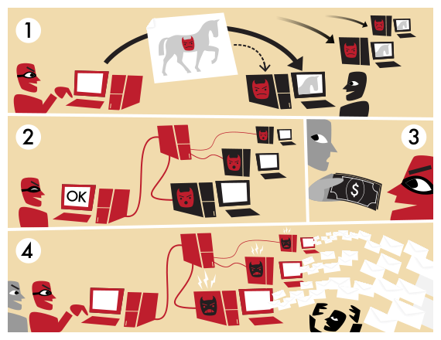
Botnet quick overview

Slide 4
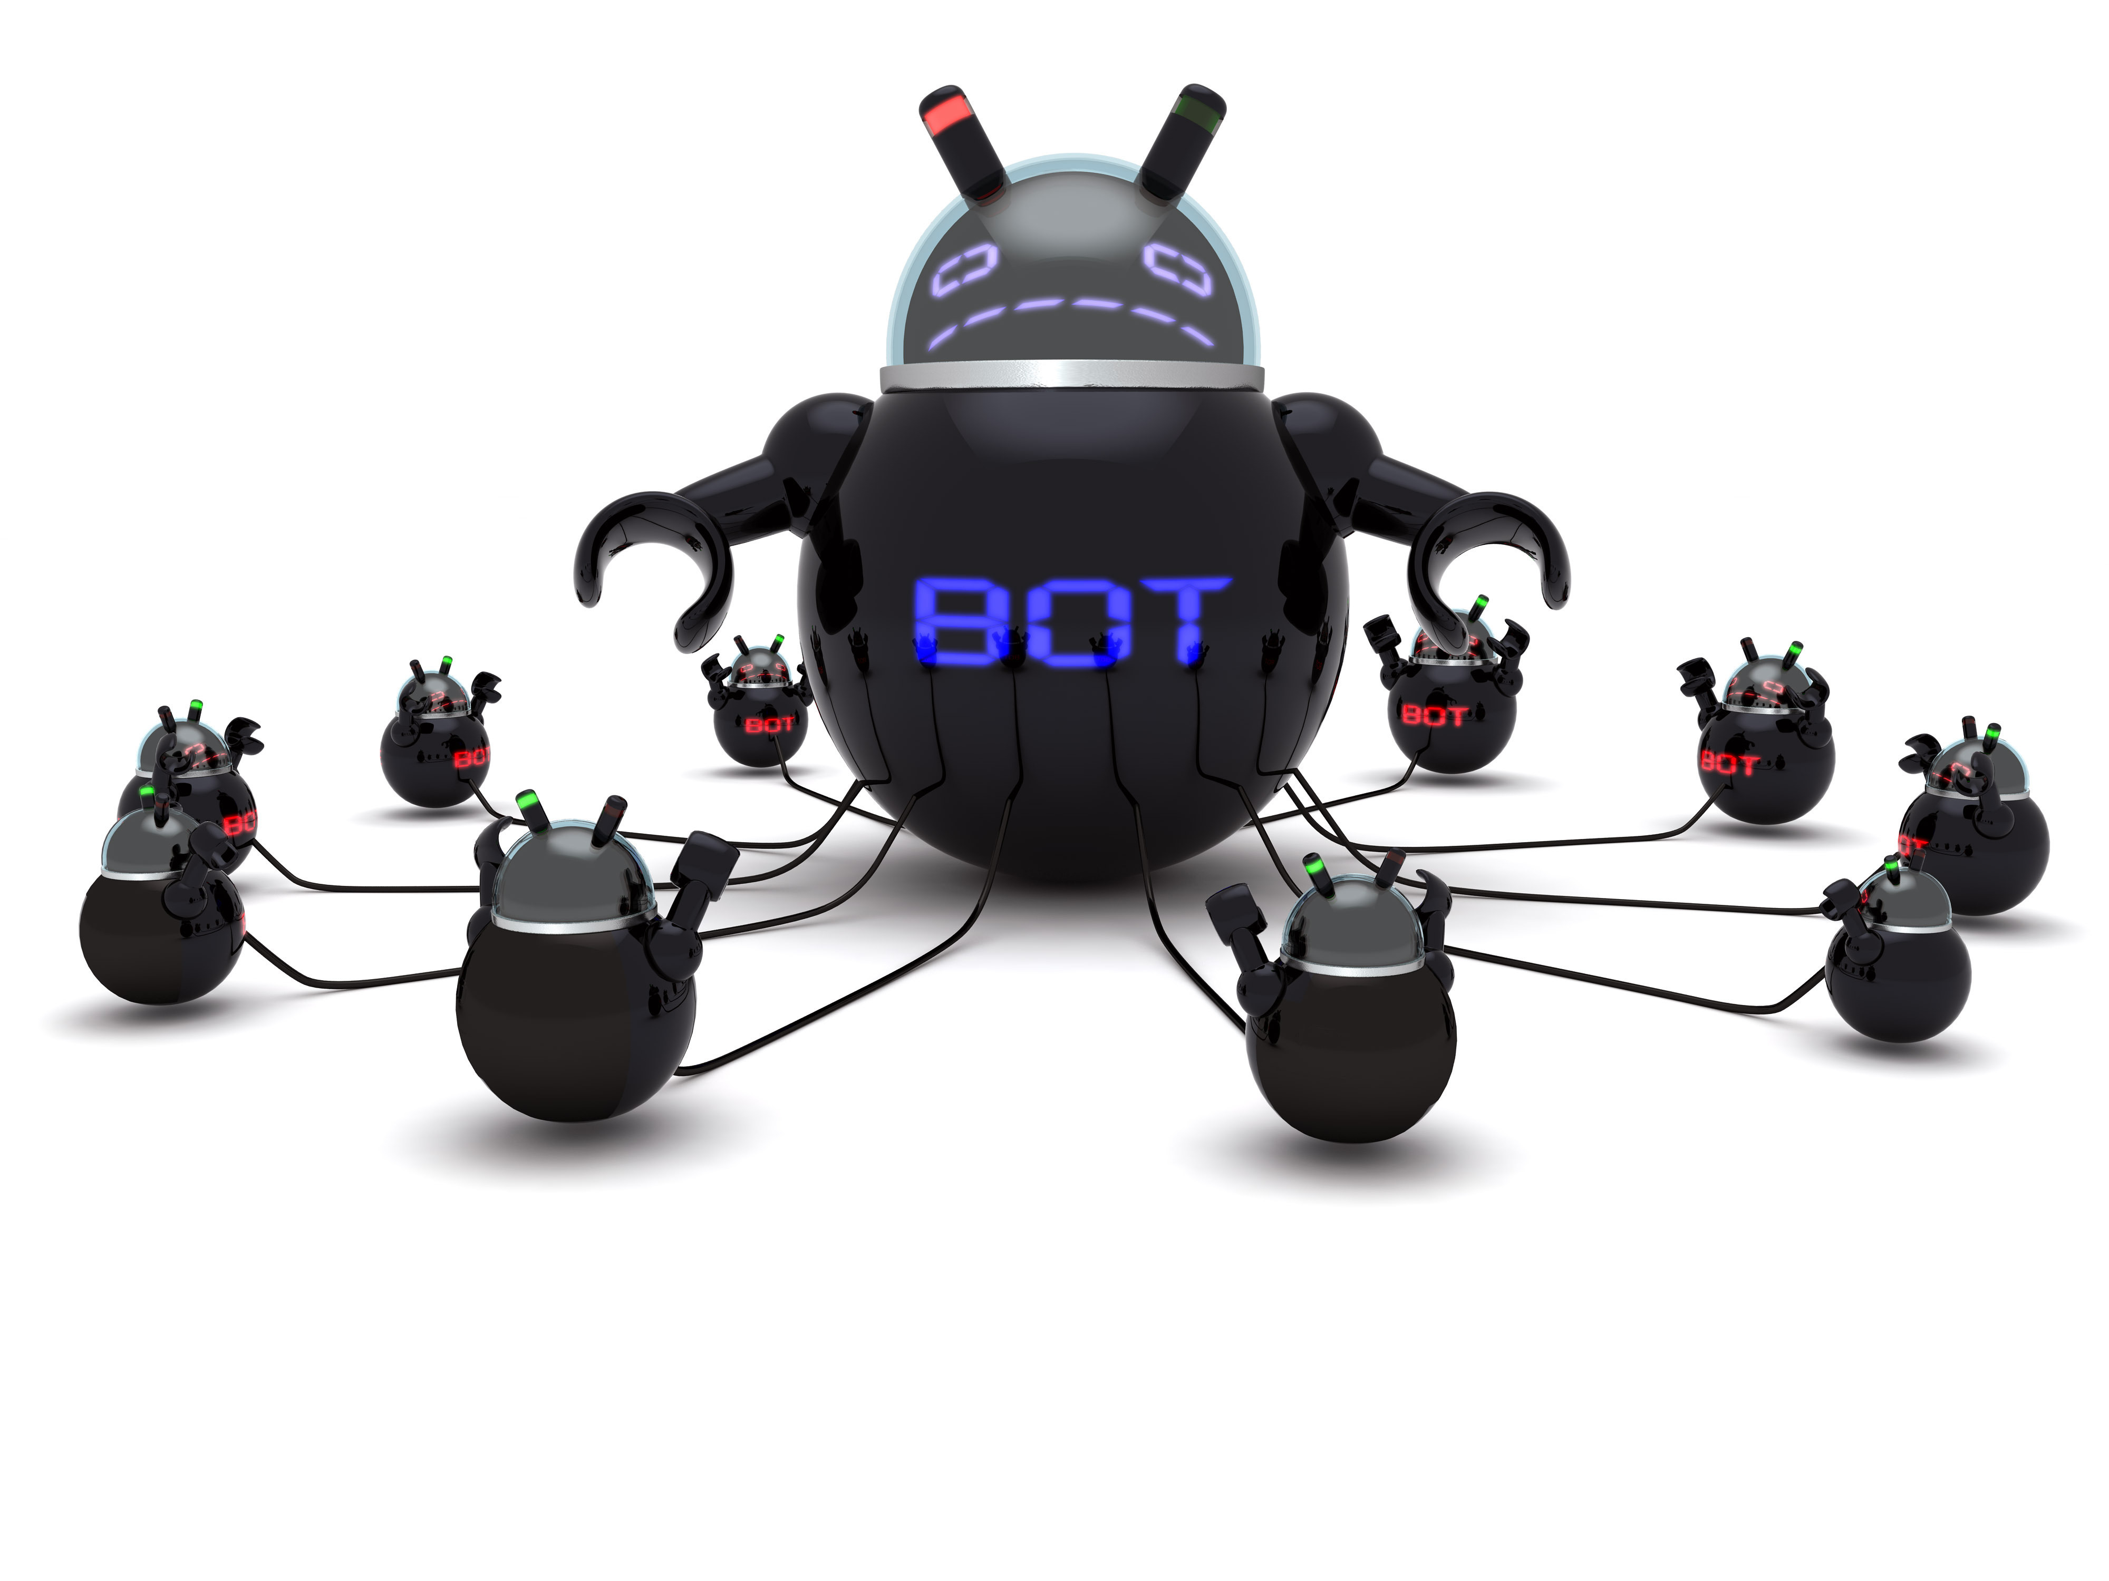
Botnet quick overview
There’s always a C&C server in control
Domain Generating Algorithm – DGA
Malware sample needed
Honeypot to monitor

Slide 5
Botnet quick overview
How about an emerging botnet ?
A botnet no one heard of yet … what then ?

Slide 6
Botnets: How do they behave
Fortunately they behave in a predictable manner
A few possible approaches:
Internet user behavior – buckets of users
Network traffic patterns

Slide 7
Internet user behavior
Straight forward approach:
Anonymize user’s personal data (IP address)
(machine) learn about its usual internet behavior
Create buckets of behaviors
Throw users in buckets
Observe anomalies occuring
Ex.: A user that never visited a .ru site, is now doing different DNS requests that end up in timeout. Next day there are 100 users with the same behavior.

Slide 8
Network traffic patterns
Spam bots and why they are special
Spam botnets are the most common way of sending spam
because they can easily be automated:
1. An outbreak of viruses and worms is sent in the wild,
infecting systems and deploying a malicious application
– the bot.
2. The bot registers with a command and control (C&C)
server controlled by the botnet operator and is ready to
receive and serve several commands, such as sending
emails from via SMTP.
3. Spammers purchase email-sending services from the
operator, providing them with templates and target
address lists.
4. The operator instructs the compromised machines to send
out spam messages.

Slide 9
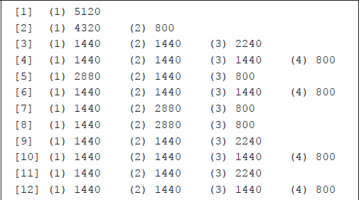
Network traffic patterns
client.write( buff5k );
[<session #>] (<segment #>) <segment size> (<segment #>) <segment size> ...

Slide 10
Network traffic patterns
Typical example with consistent segment size.

Slide 11
Network traffic patterns
Another typical example – MSS improves to multiples of the base value.
Relay servers can be configured in numerous ways, but this pattern stands out.

Slide 12
Network traffic patterns
The headers are clearly sent in a distinct writing sequence.
The SMTP sequence for ending the data transmission is sent in its own segment
Distinct FROM header

Slide 13
Takeaway
There are interesting approaches for detecting botnets, besides sinkholes.
Analyzing user behavior with machine learning and event correlation engines
Network traffic patterns
ssofronie@bitdefender.com

